Slide 1
Master
Programming in C
| Day - 8 |
presented by - Subhadip Roy

Slide 2


Slide 3

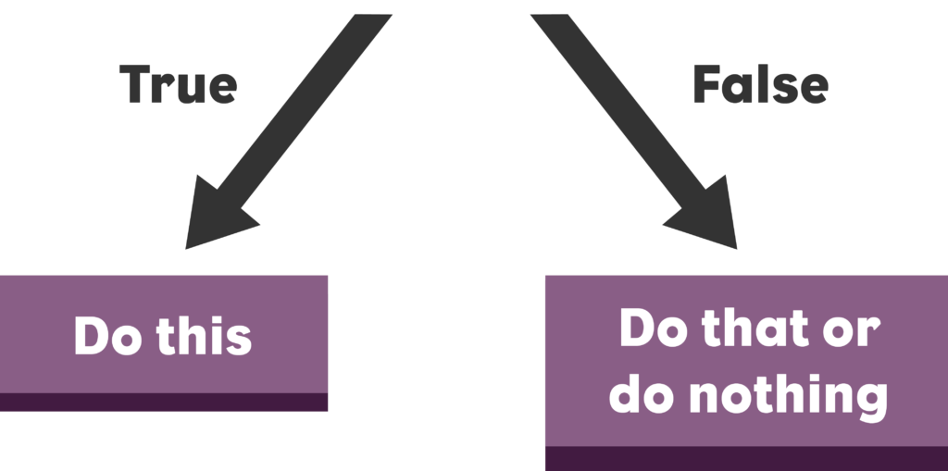
CONDITIONALS

Slide 4
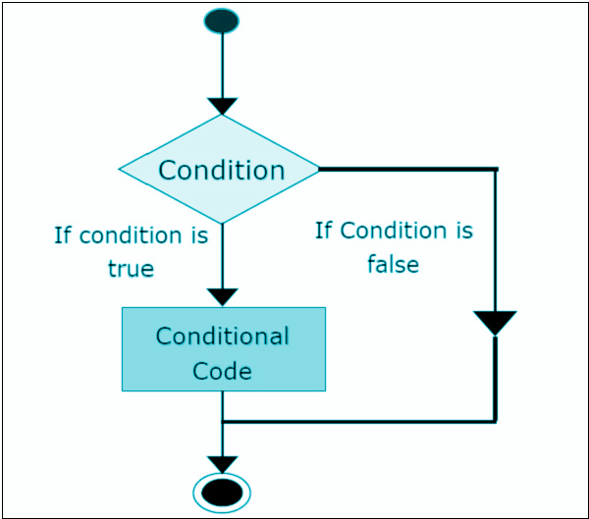
IF-ELSE

Slide 5
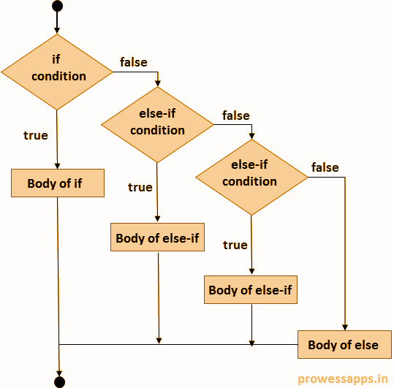

if{
------
}
else if{
------
}
else{
------
}
ladder

Slide 6
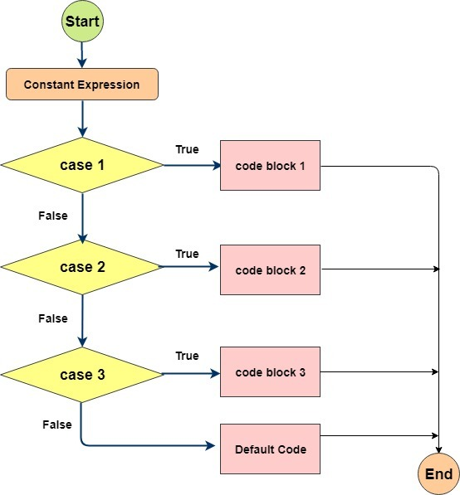

SWITCH
Statement

Slide 7

FALLTHROUGH

Slide 8
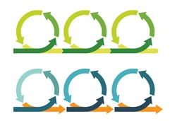

ITERATION / LOOPING
do
while
for
while
Cont
inue
break
goto

Slide 9
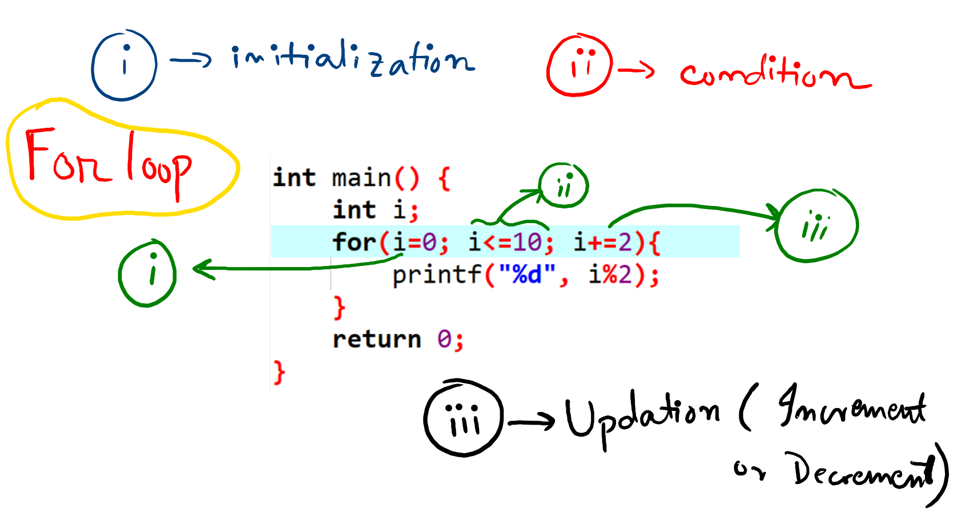

Slide 10
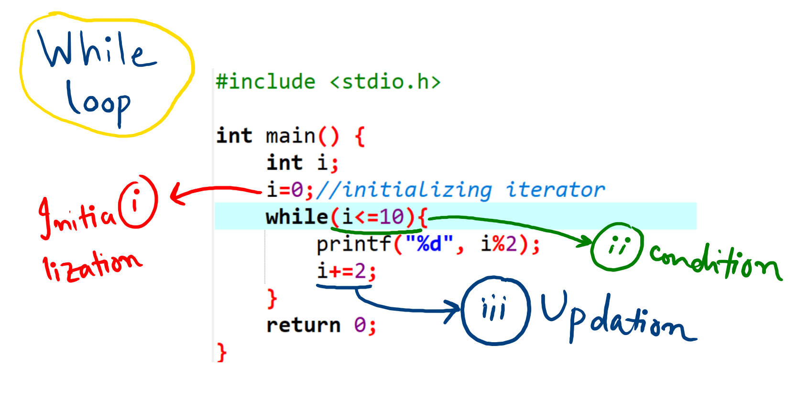

Slide 11
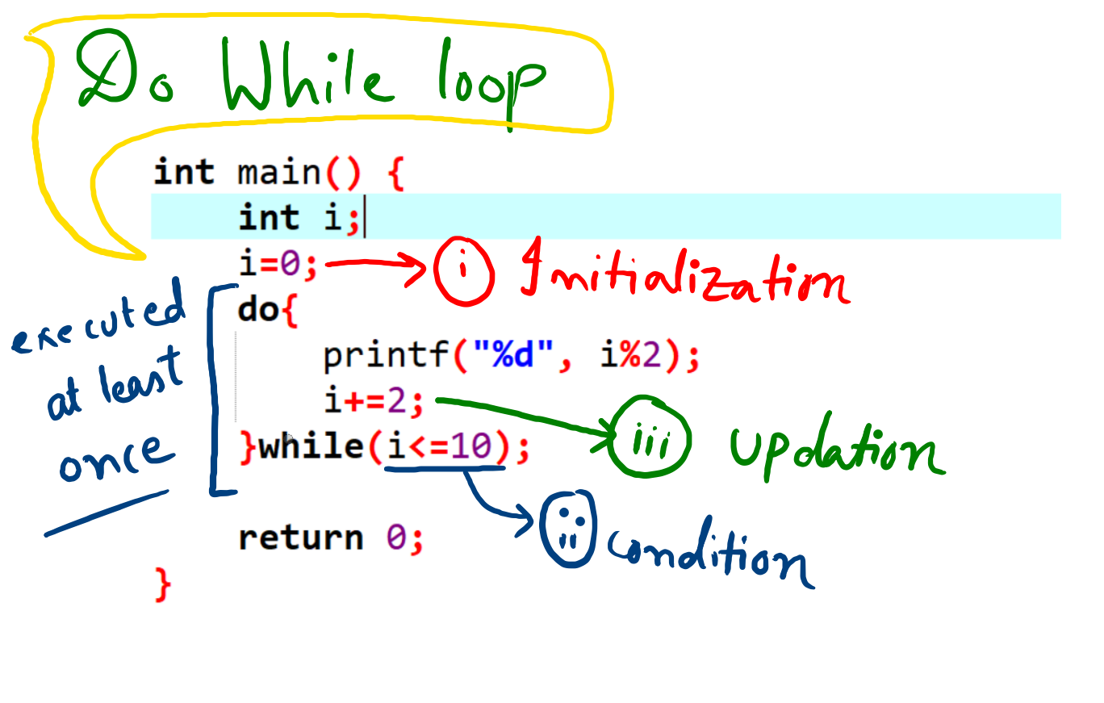

Slide 12


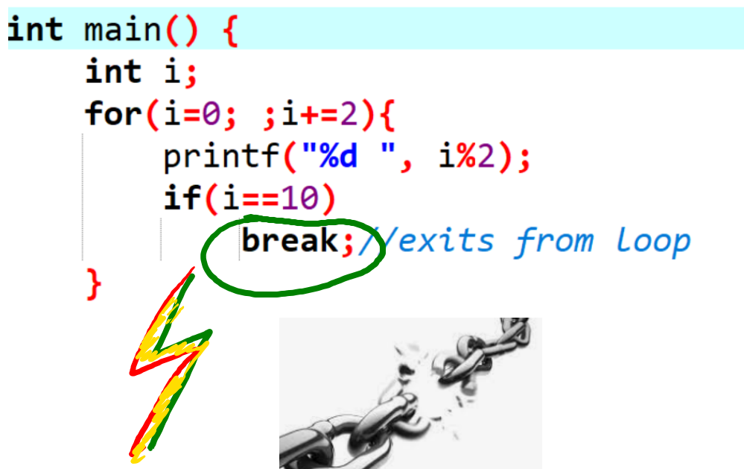


Slide 13
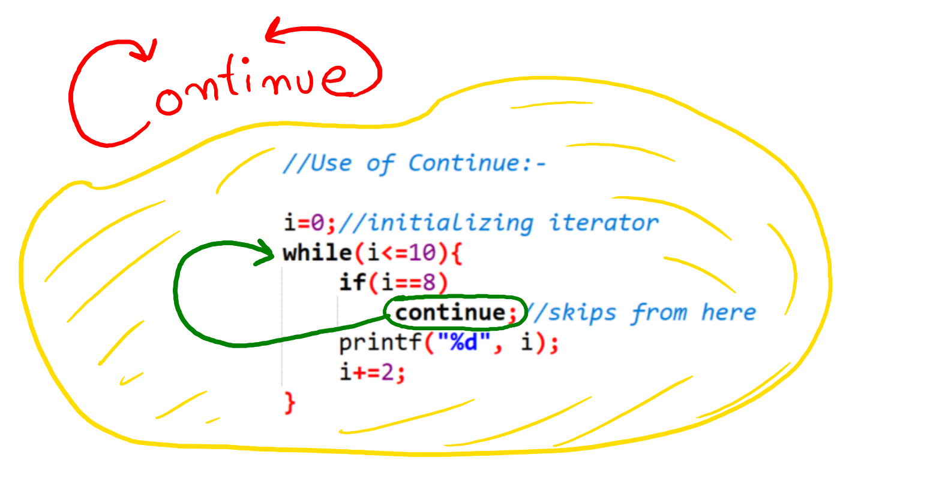

Continue

Slide 14
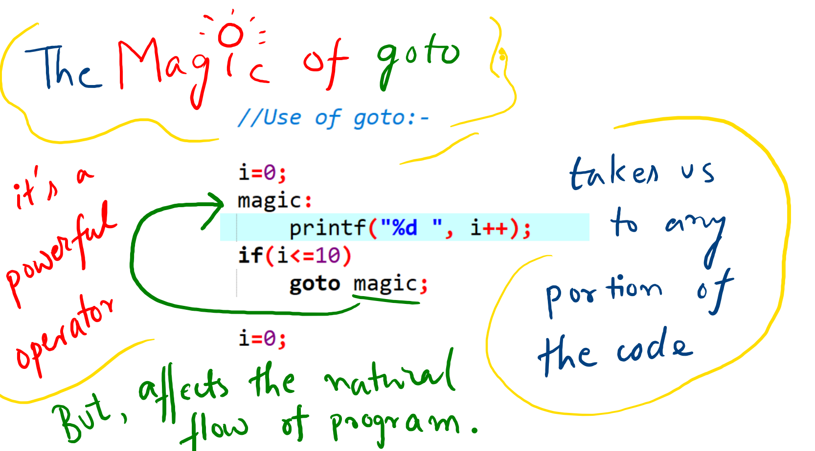

Goto

